Slide 1

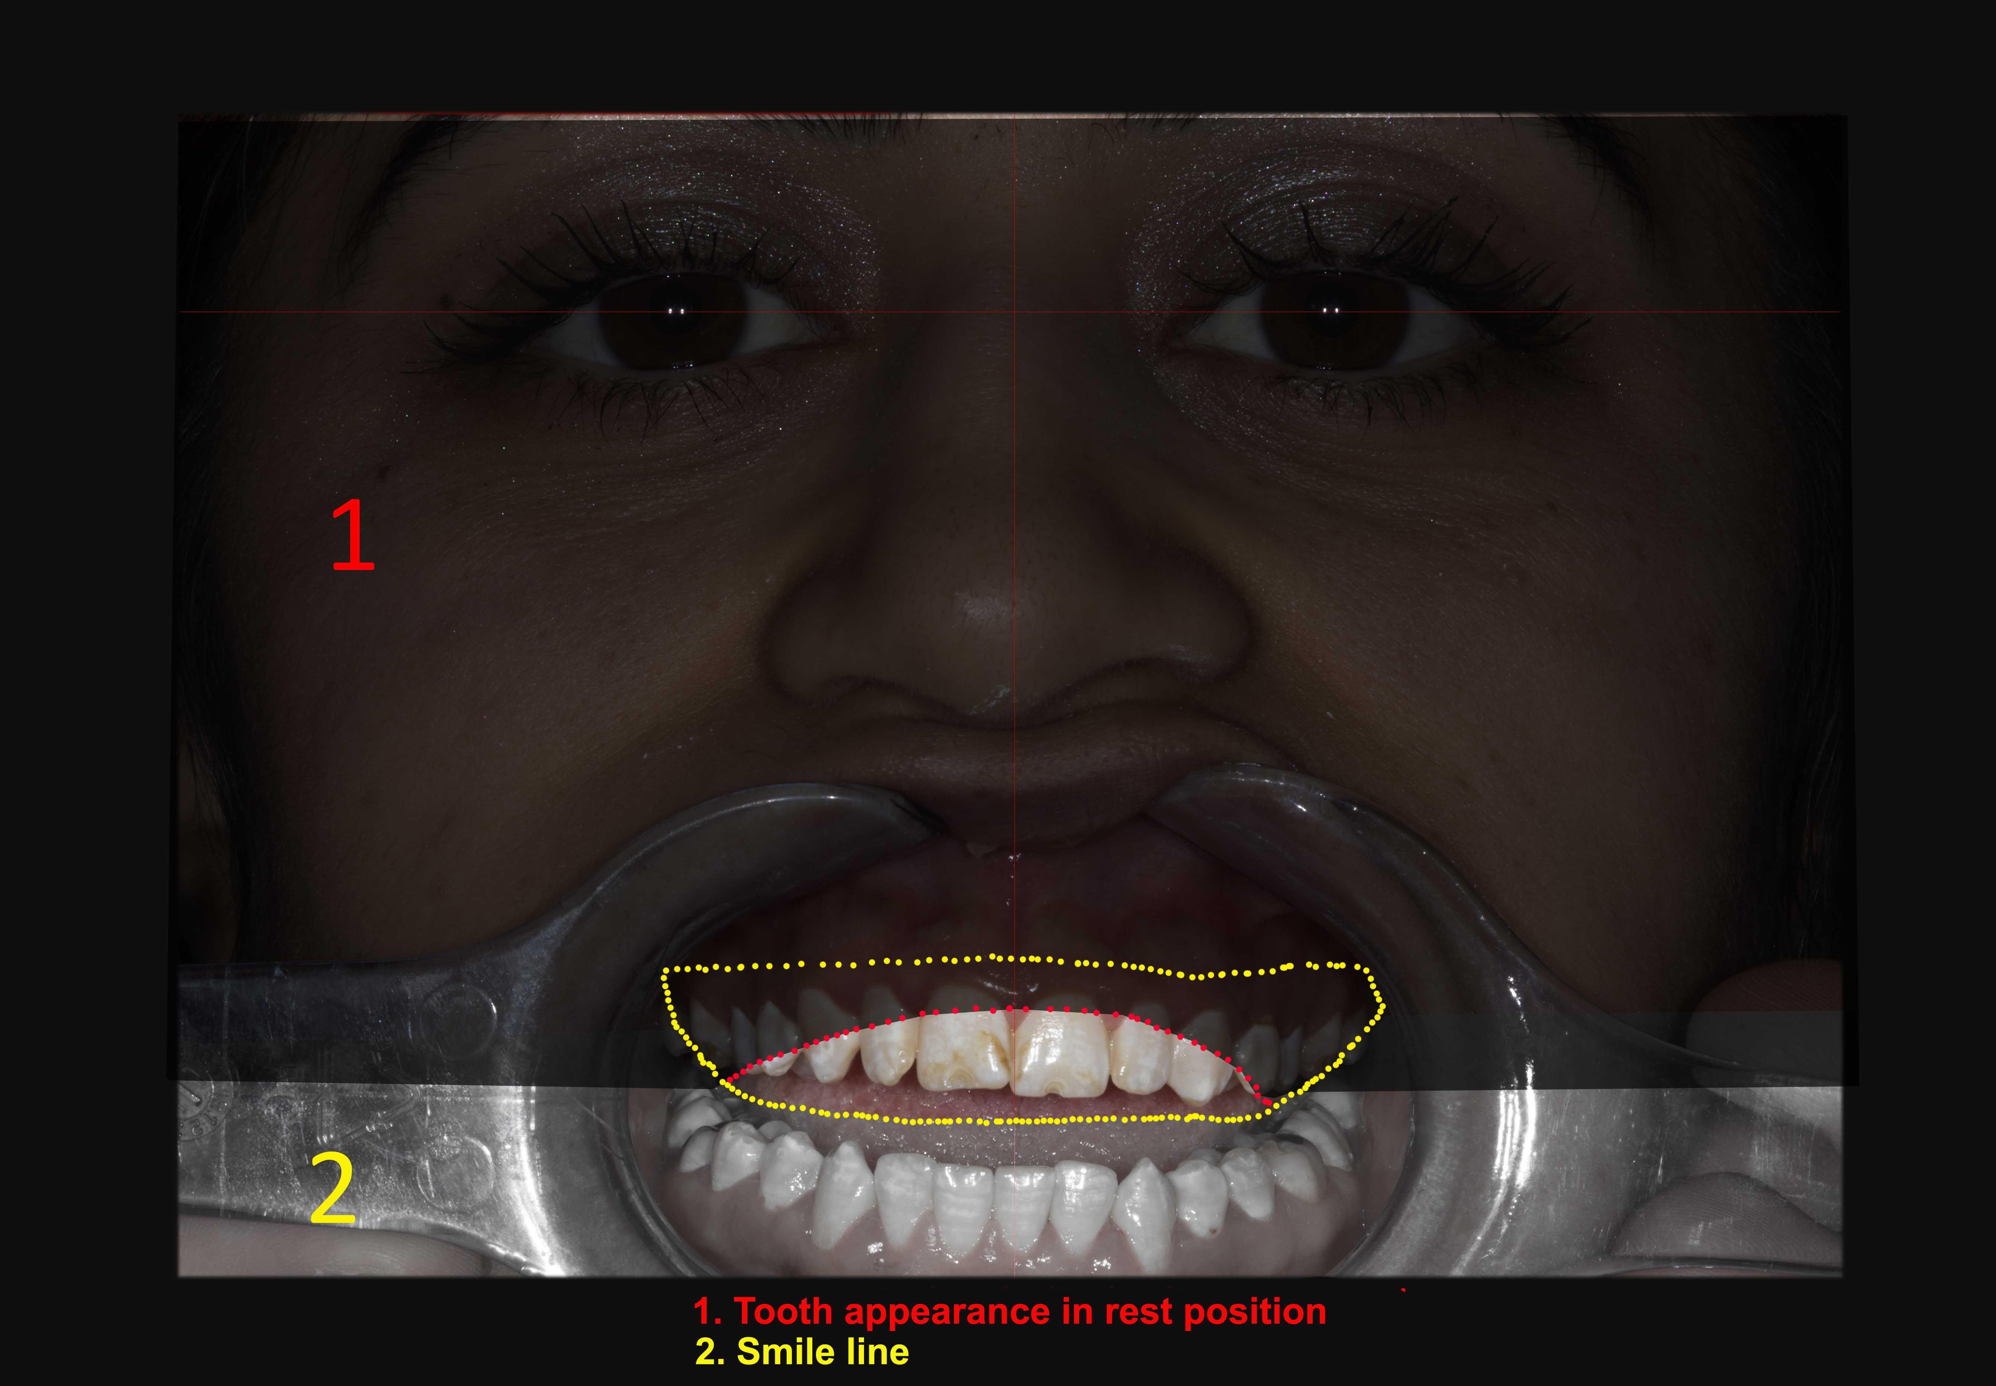
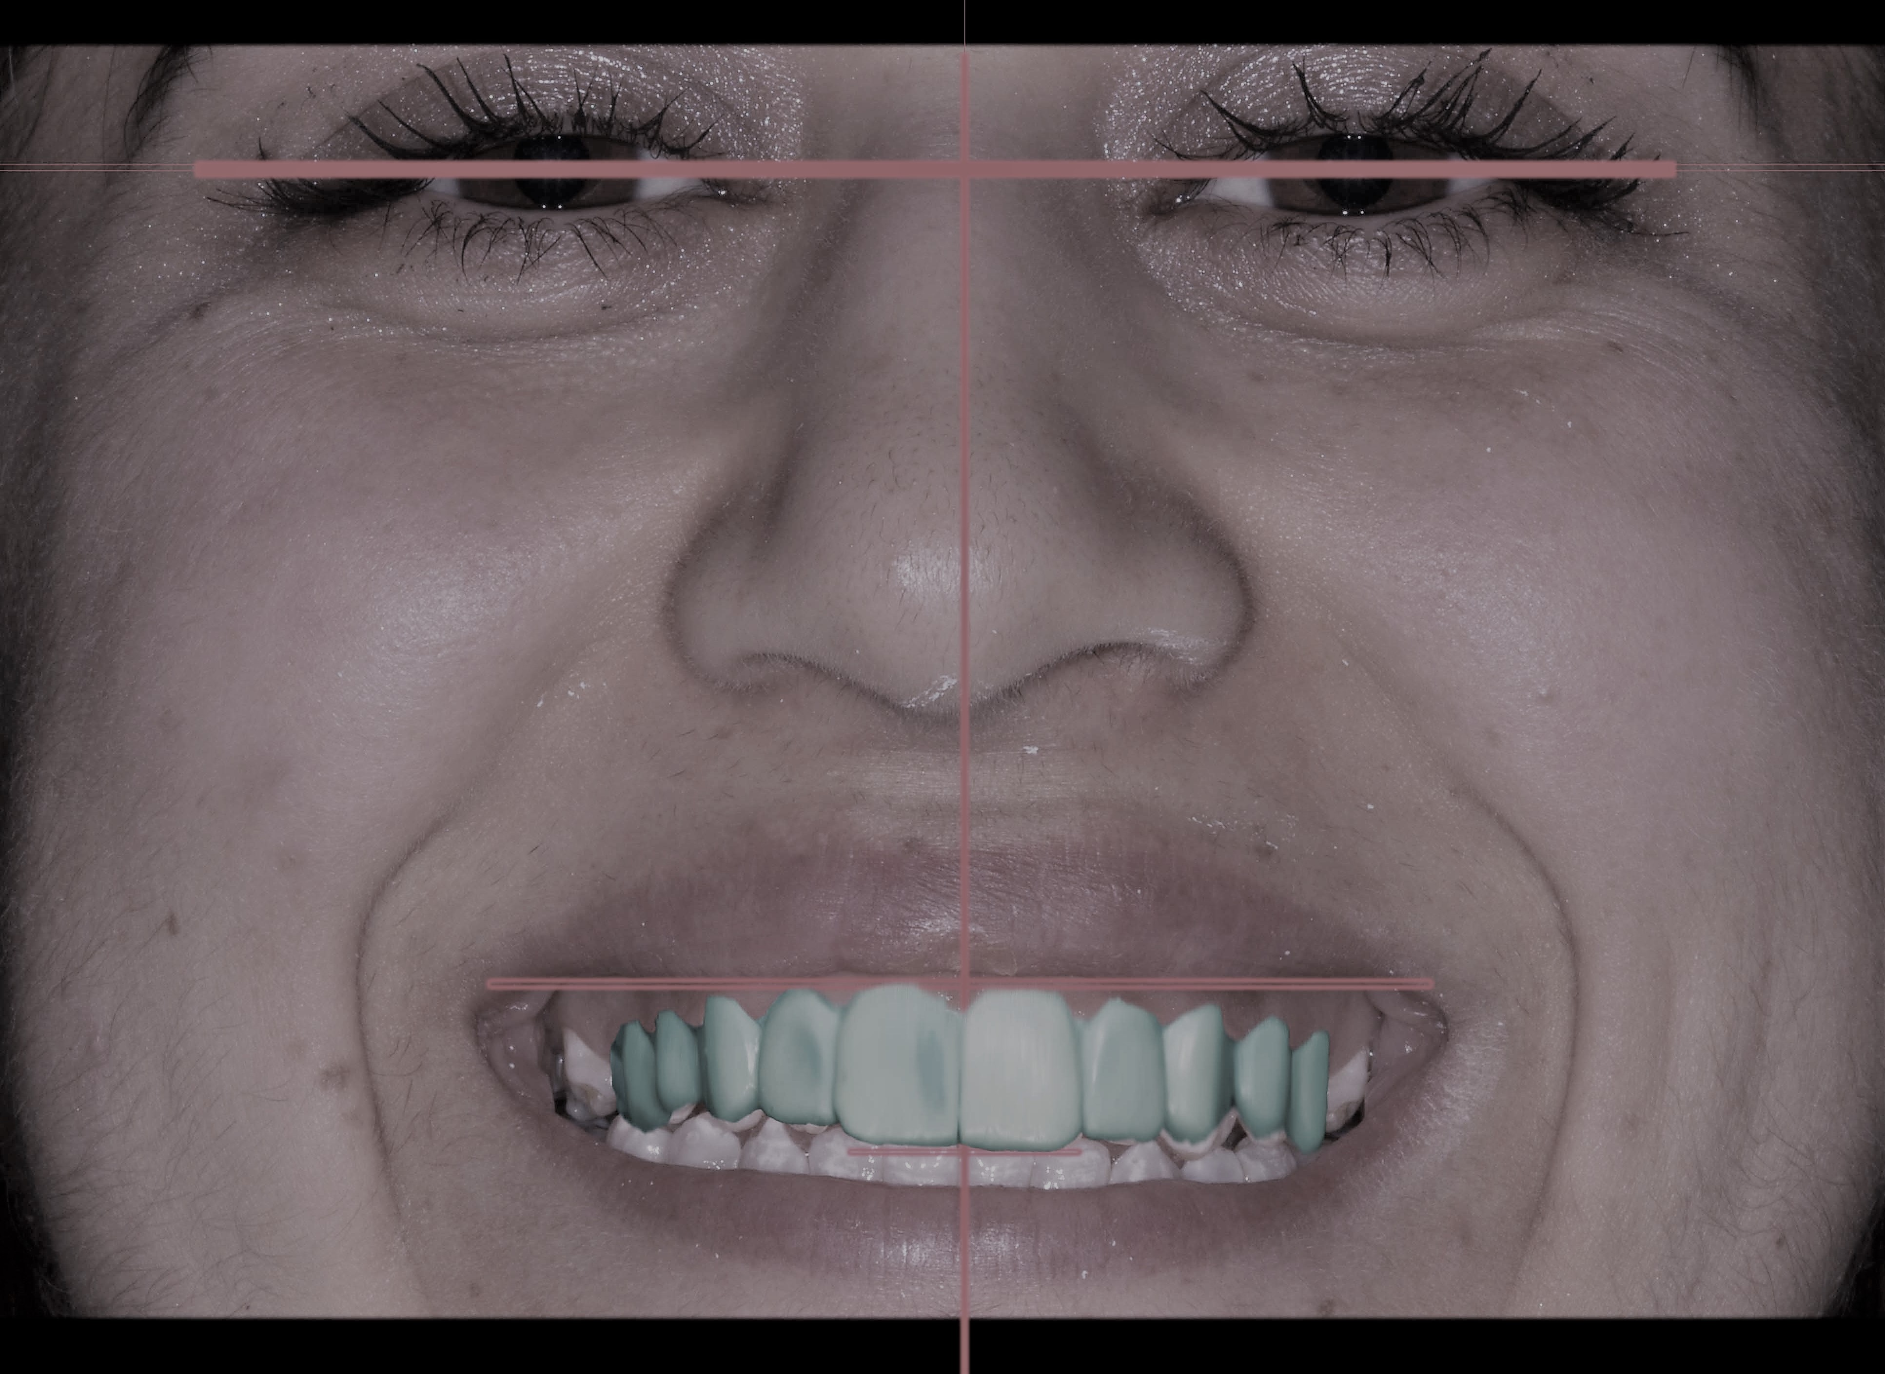
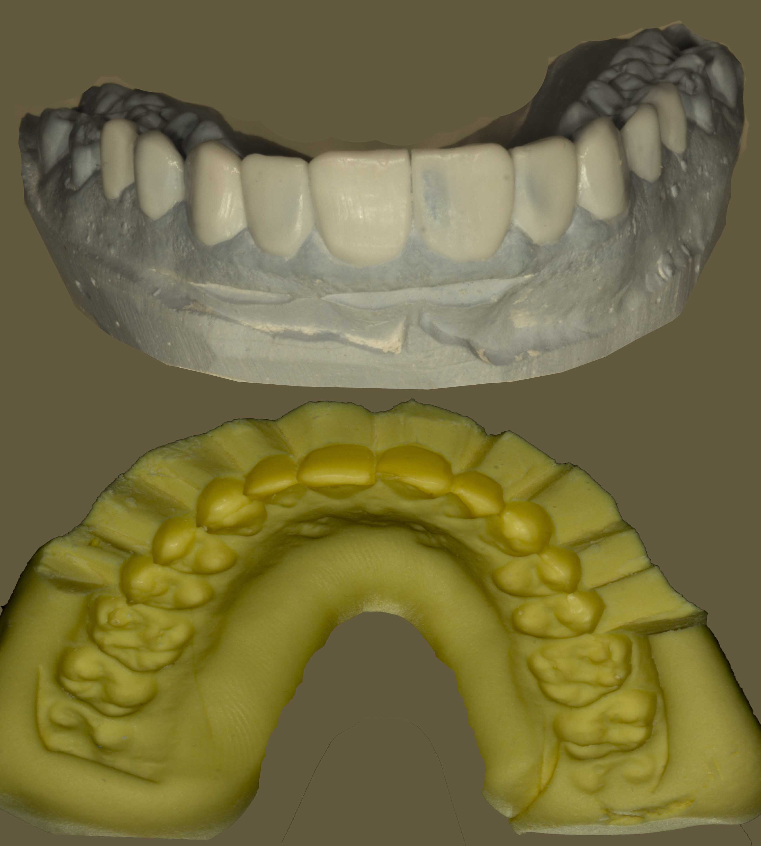
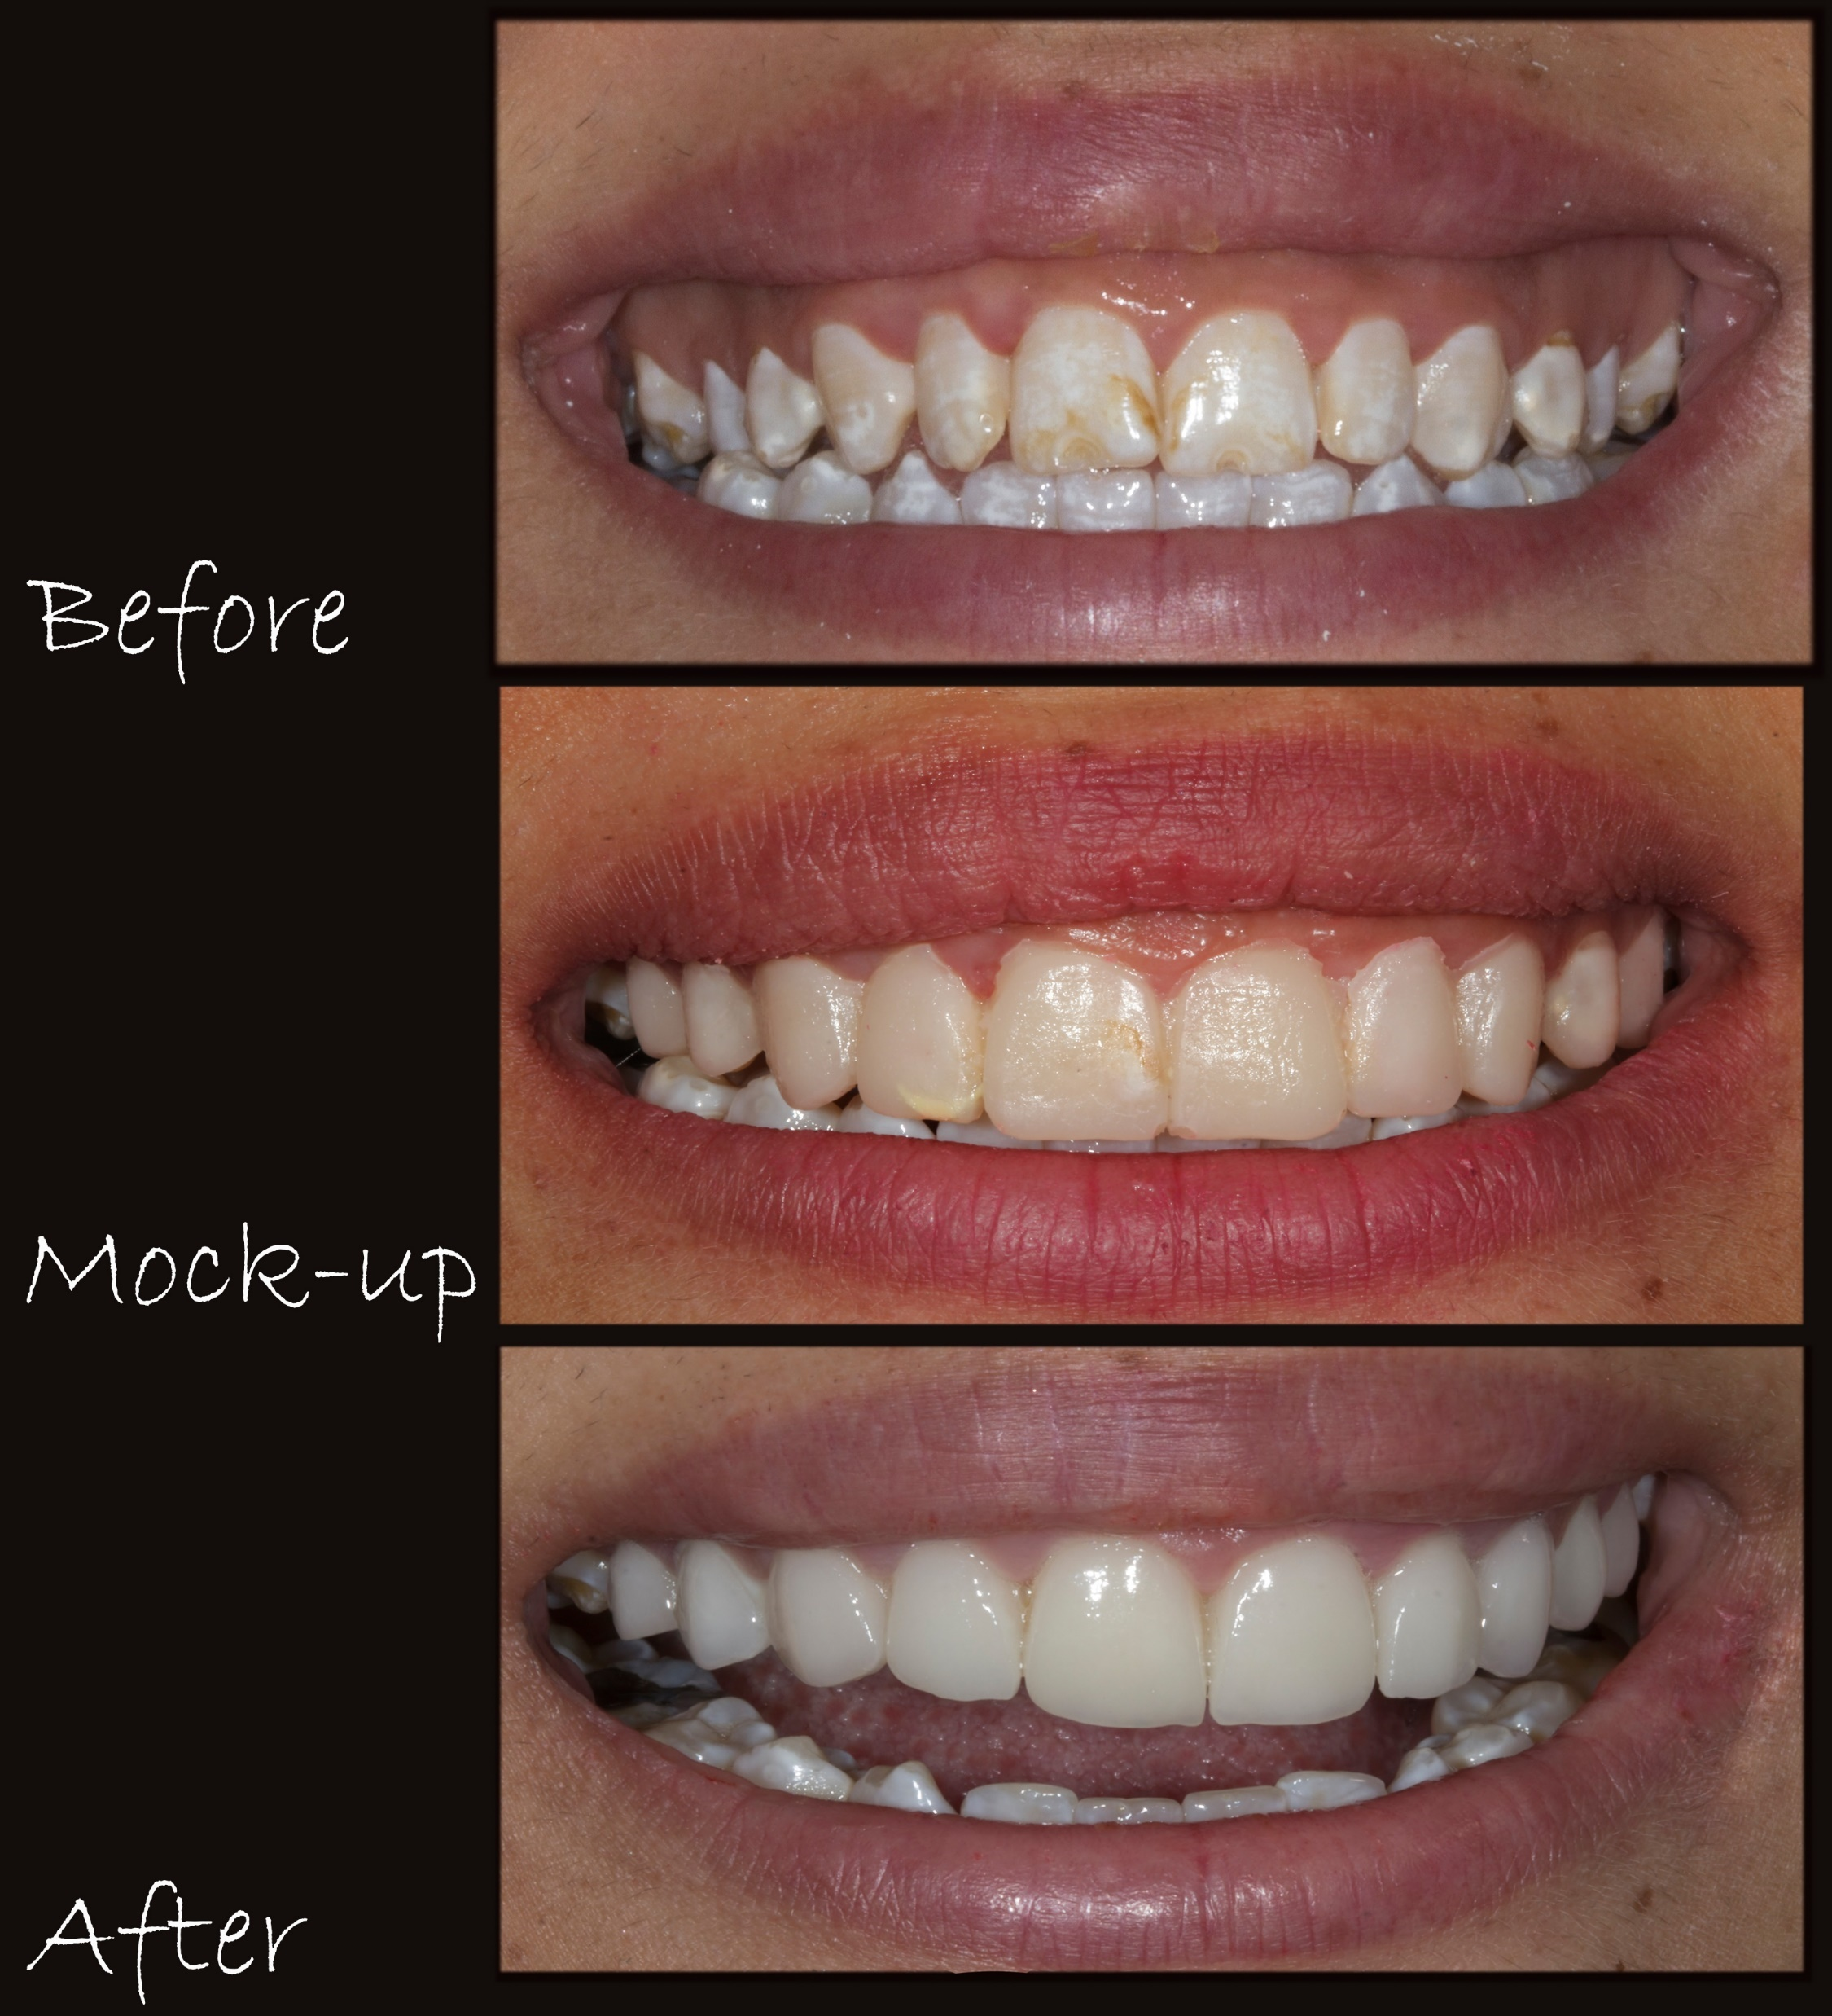
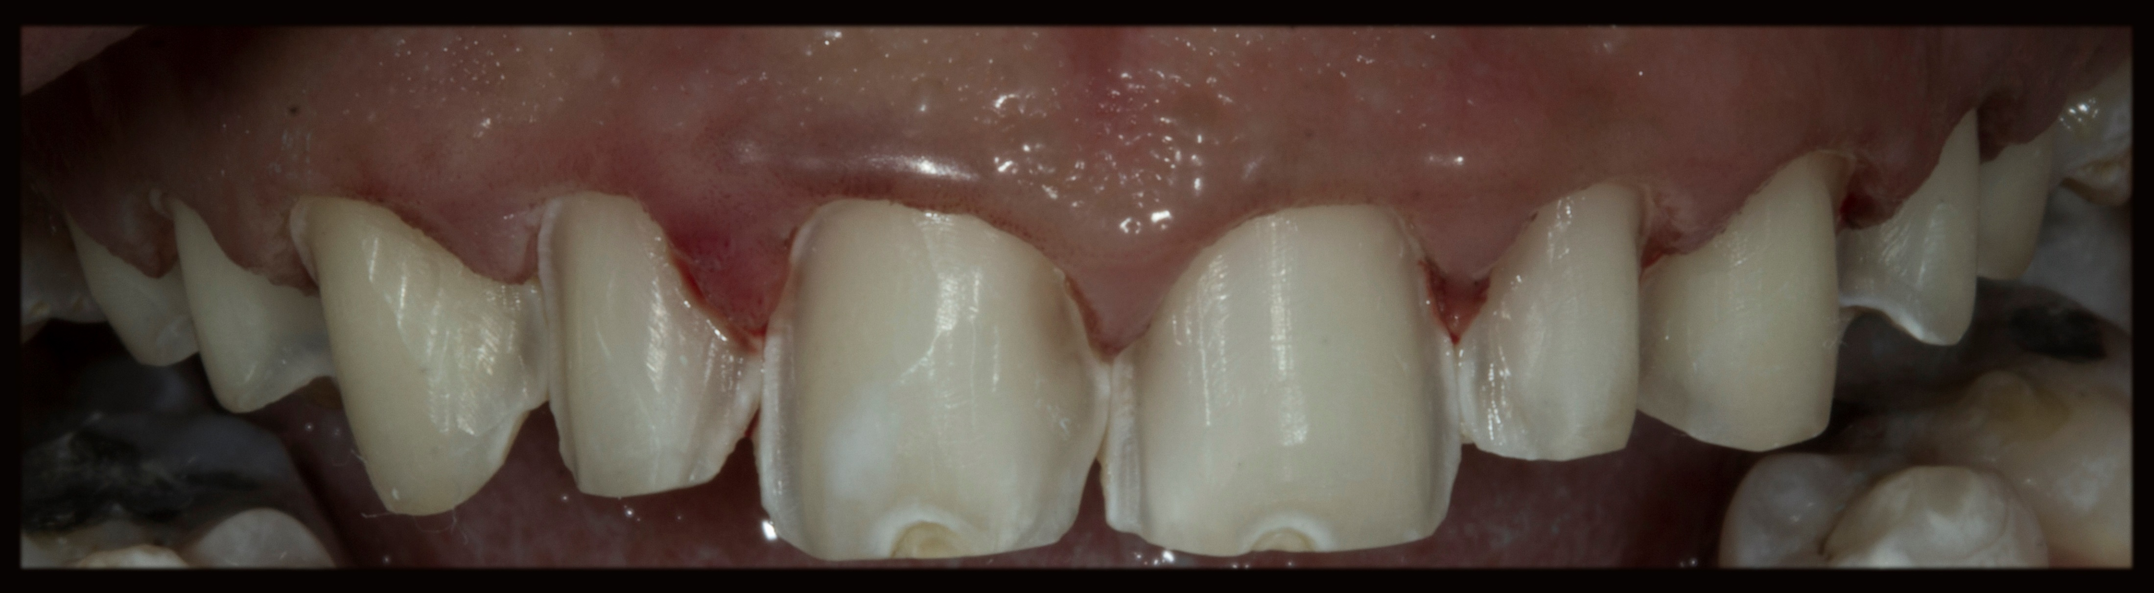
In The Patient With Enamel Hypoplasia, Smile Design With The Photoshop Programme; A Case Report
Ahmet ŞANVERª, Yunus Emre ÖZDENª, Burak AĞARª, Fatma PEHLİVANLARª a. Hacettepe University Dentistry Faculty, Prosthodontics, Ankara, Turkey
ABSTRACT
A 22-years-old female patient with enamel hypoplasia applied to Hacettepe University Dentistry Faculty Prothodontics Department. Clinical and radiographic examinations were not observed the obstruction of treatment. Parafunctional habits of the patient was questioned. In a patient who complained of aesthetics; digital wax-up application was done using Photoshop computer programme. (fig.1,2) After the patient was approved in the digital environment, the data was sent to the laboratory. After the wax-up application of the plaster model wax-up in the laboratory, mock-up application was made in the mouth. (fig.3) Smile design was provided with laminate veneer crowns. (fig.4,5) In this poster, prosthetic rehabilitation with laminate veneers is described in the direction of the smile design made using the photoshop computer programme of the patient with enamel hypoplasia.
Fig.4
Fig.1
Fig.2
Fig.3
Conclusion
An organized and systematic approach is required to diagnose esthetic problems predictably. So that, wax-up and mock-up applications have a critical appeal in the indication of aesthetic restorations. The smile design made with Photoshop can help to dentist for an indication, it can give an idea of ​​how the patient's prosthesis will look an help to the technician to transfer the anticipation of both the patient and dentist.
Fig.5

